Slide 1
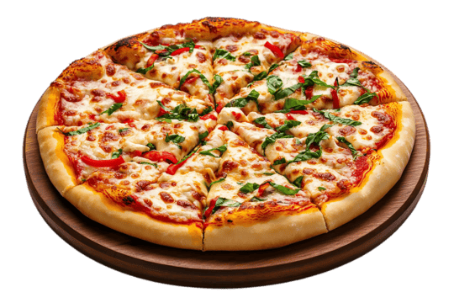

Pizza Sales Data Analysis Project
Pizza Sales Data Analysis Project – Summary

Slide 2
Pizza Sales Data Analysis Project – Summary
This project focuses on analyzing pizza sales data using SQL queries to uncover important insights about customer behavior, order patterns, and revenue performance. Multiple SQL operations such as aggregation, joins, grouping, and ordering were used to extract valuable business insights from the dataset, which includes tables like orders, order_details, pizzas, and pizza_types.

Slide 3
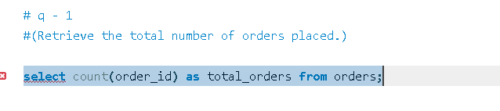
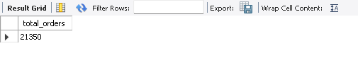
Total Orders
The total number of orders placed was calculated using the COUNT() function on the orders table, giving a clear picture of total sales volume.

Slide 4
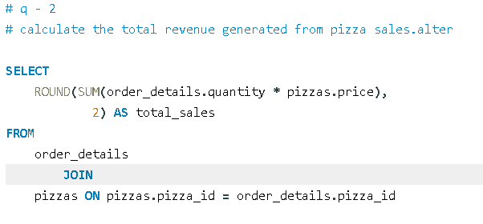
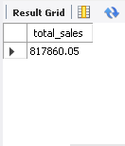
Total Revenue Generated
By joining the order_details and pizzas tables, the project computed the total revenue using the formula: SUM(order_details.quantity * pizzas.price).
This helped determine the overall sales performance.

Slide 5
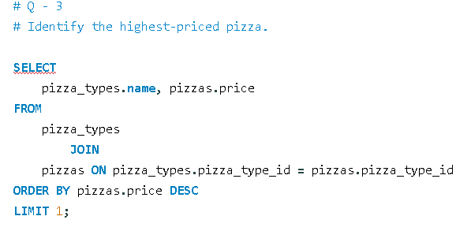
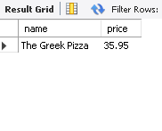
Highest-Priced Pizza
A join between pizza_types and pizzas revealed the most expensive pizza, identifying premium menu items that contribute to higher revenue.

Slide 6
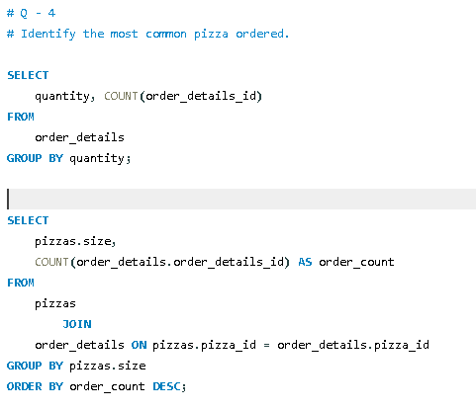
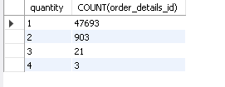
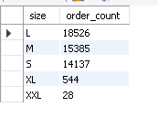
Most Common Pizza and Sizes Ordered
Queries grouped by quantity and size highlighted the most frequently ordered pizza sizes and quantities preferred by customers.

Slide 7
Top 5 Most Ordered Pizzas By summing the quantity for each pizza type and sorting in descending order, the top 5 most popular pizzas were identified.
Total Quantity per Category Aggregating data by category showed which pizza categories (e.g., Veggie, Chicken, Classic) had the highest sales volume.
Order Distribution by Hour Using the HOUR() function, the project analyzed order patterns throughout the day, revealing peak ordering hours for operational insights.
Pizza Category Distribution Grouping by category provided a clear view of the menu composition and the variety of pizzas offered.
Average Pizzas Ordered per Day By grouping by order_date and calculating the average quantity, the project identified daily order trends.
Top 3 Pizzas by Revenue A final query combining pizza_types, pizzas, and order_details determined which pizzas generated the highest total revenue, offering insights into the best-performing products.

Slide 8
Conclusion
This SQL-based analysis provided a comprehensive understanding of pizza sales trends. It identified:
The most popular pizza types and sizes
The peak hours and days for orders
The highest revenue-generating items
The contribution of each category to total sales
Such insights can help a pizza business improve menu strategy, pricing decisions, and marketing campaigns to maximize customer satisfaction and profitability.

